Slide 1

AIORI HACKATHON 3 · SMART CITIES
A3-PS003-TC008
FedTraffic
Federated Traffic-Flow Prediction with Communication-Cost Evaluation
Sajal Gupta
sajal.gupta.1027@gmail.com
Abhinav Hari K
abhinavhari2044@gmail.com
Gowtham (Mentor)
gowthamgopal16@gmail.com
AIORI Hackathon 3 · A3-PS003-TC008

Slide 2
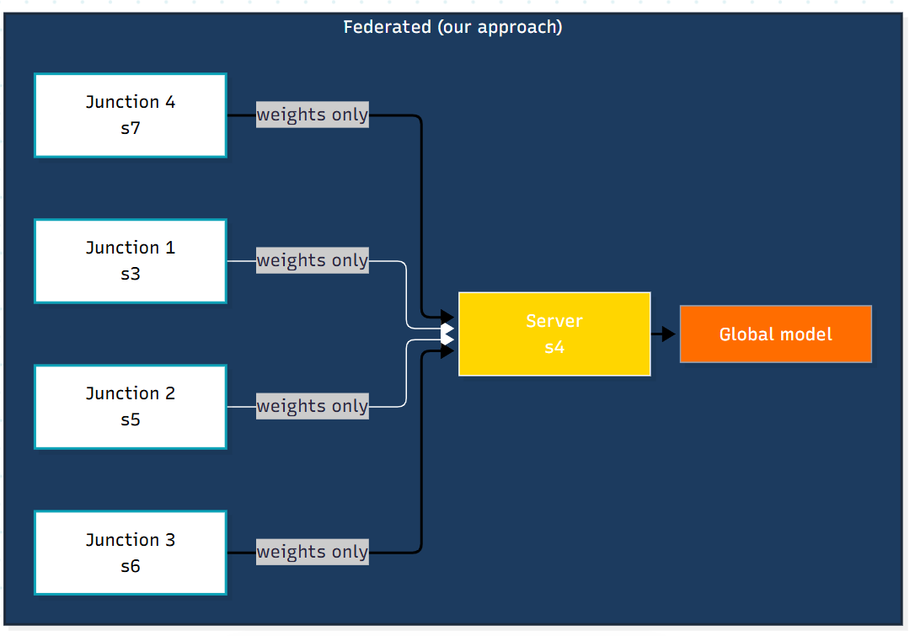
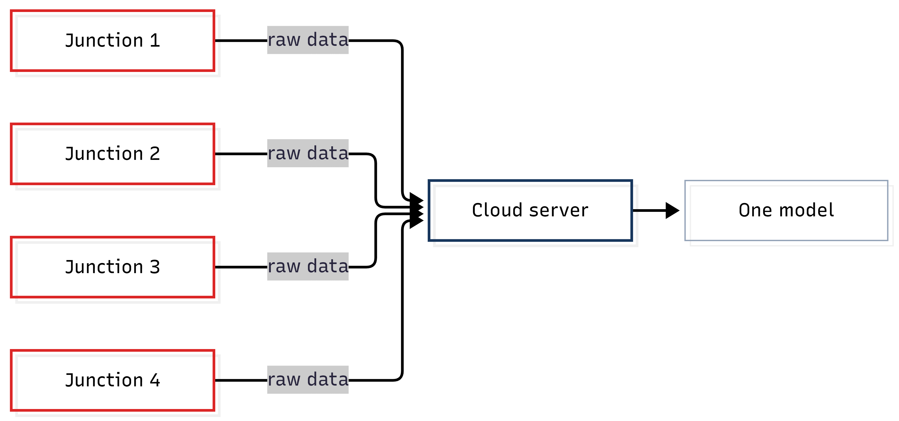
01
Problem Description
Traffic forecasting normally streams raw sensor data to a central cloud: heavy on bandwidth, and private travel logs end up in one place.
Federated learning keeps data at each junction and shares only model weights.
Our question: how accurate is it when junctions differ (non-IID), and what does each round cost in bytes?
Scope: a simulation. No live cameras, no city-wide deployment, no formal privacy guarantees.
Raw data leaves every junction: heavy on bandwidth, private logs in one place.
Only model weights leave. Raw data stays at the junction.
AIORI Hackathon 3 · A3-PS003-TC008
2 / 11

Slide 3
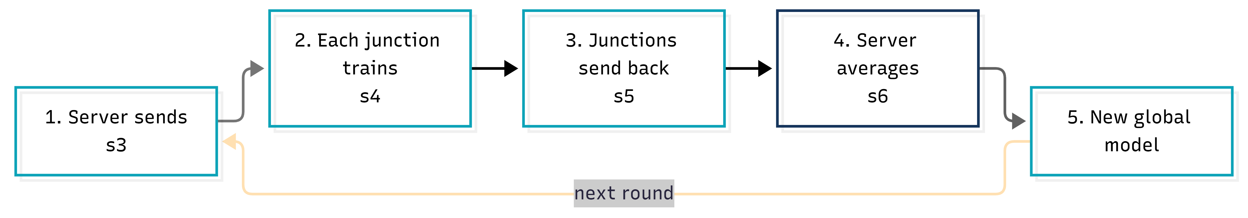
02
Background
WHY NOT COIMBATORE?
FedAvg : the server sends the model, clients train locally, and the server averages the returned weights.
IID vs non-IID: non-IID means clients hold different data. Here, junction traffic differs a lot.
Why it matters: federated learning’s core challenges include communication cost and statistical heterogeneity.
Our metrics: MAE, RMSE, bytes per round, convergence.
02
Junction 1 carries about six times the traffic of Junction 4. That’s why averaging models across them is hard.
AIORI Hackathon 3 · A3-PS003-TC008
3 / 11

Slide 4
03
Literature & RFC Review
Prior work focuses on accuracy and privacy. We add a controlled study of IID vs non-IID and communication bytes per round on a small, reproducible simulator
1
2
3
McMahan et al.
Li at al
Sattler et al.
“Federated Learning with Non-IID Data”
AISTATS 2017
IEEE SPM 2020
IEEE TNNLS 2020
“Communication-Efficient Learning of Deep Networks from Decentralized Data”
“Diffusion Convolutional Recurrent Neural Network: Data-Driven Traffic Forecasting”
Introduces FedAvg - the aggregation algorithm at the core of our federated loop.
Notes that federated learning has significant communication overhead, and that non-iid client data is the realistic case where simple methods struggle
Motivates measuring bytes and testing non-IID
IEEE survey of federated learning’s challenges and approaches
The paper that introduced the METR-LA dataset we build and evaluate on.
Frames our focus on communication and non-IID data
AIORI Hackathon 3 · A3-PS003-TC008
4 / 11

Slide 5
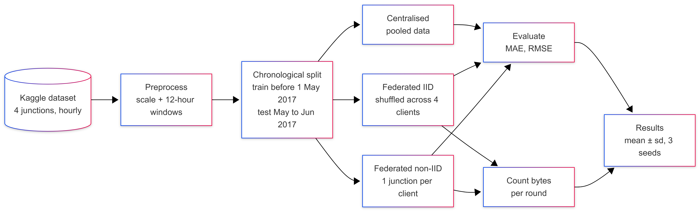
04
Proposed Solution
Same data and same model in all three setups. The only thing that changes is how training happens.
AIORI Hackathon 3 · A3-PS003-TC008
5 / 11

Slide 6
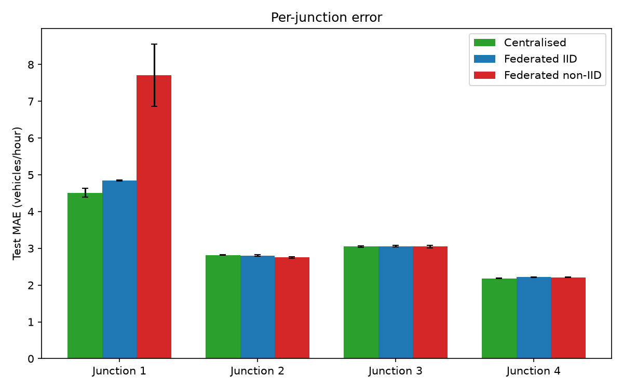
05
Solution Optimization
Take Aways -
IID federated is about 3% worse than centralised.
Non-IID is about 25% worse and less stable.
The damage is mostly at Junction 1: MAE 4.5 → 7.7.
30 rounds cost about 3.1 MB, more than the roughly 165 KB raw data (approximate). The benefit here is data staying local.
 | Central | Fed IID | Fed non-IID
MAE | 3.141±0.026 | 3.232±0.004 | 3.931±0.201
RMSE | 4.927±0.047 | 5.109±0.012 | 6.354±0.348
Rounds to converge | ~7 epochs | ~16 | ~20
Bytes per round | n/a | 108,576 | 108,576
Raw data leaves | Yes | No | No
AIORI Hackathon 3 · A3-PS003-TC008
6 / 11

Slide 7
06
Solution Architecture & Design
Logical architecture | Components are logical modules implemented across the project scripts
Preprocessor
prepare_data.py
Scale + 12-hour windows
GRUNet
12-hour input · 32 hidden units
3,393 parameters
CommTracker
bytes_per_round
cumulative_bytes
Server
broadcast(global model)
FedAvg(weighted by data size)
Partitioner
IID shuffle / non-IID
1 junction per client
Client × 4
local_train(global weights)
send_weights()
Evaluator
MAE · RMSE
per-junction metrics
ExperimentRunner
central / IID / non-IID
seeds 0, 1, 2
Data stays at each client. Only model weights/updates are exchanged; evaluation records prediction errors and communication cost.
AIORI Hackathon 3 · A3-PS003-TC008
7 / 11

Slide 8
07
Data Flow Diagram
traffic.csv · 4 junctions, hourly counts
Preprocess
Scale + 12-hour windows
Chronological split
Train before 1 May 2017 | Test: May–Jun 2017
Each federated round × 30
Server sends global model
4 clients train 1 local epoch
CENTRALISED PATH
Pool all junctions
FEDERATED PATH
Partition into 4 clients
Train one GRU
30 epochs
IID
Shuffle / deal
Non-IID
1 junction/client
Clients return weights only
FedAvg weighted average
Evaluate on test set: MAE · RMSE · per-junction error | Mean ± SD over seeds 0, 1, 2
Communication tracked: 108,576 bytes per federated round • Raw traffic data never leaves clients
AIORI Hackathon 3 · A3-PS003-TC008

Slide 9
08
Deployment Timeline
Level 2 build window: 16–31 October. As a two-person team, we split ownership so both can work in parallel — one on modelling and the federated loop, the other on data, evaluation and reporting.
Setup
Federated build
Reporting
Oct 16–18
Oct 22–24
Oct 28–29
Baseline plan, data acquisition
FedAvg, IID/non-IID splits
Analysis, report, pseudocode
1
2
3
4
5
6
Baseline
Experiments
Submission
Oct 19–21
Oct 25–27
Oct 30–31
Preprocess, centralised GRU
3-seed runs, metrics
Final review, demo, submit
Steps 1–7 (GitHub setup, PDF, intro video) are already complete as part of Level 1, due 14 October.
AIORI Hackathon 3 · A3-PS003-TC008
9 / 11

Slide 10
09
Bibliography
[1]
H. B. McMahan, E. Moore, D. Ramage, S. Hampson, and B. A. y Arcas, “Communication-Efficient Learning of Deep Networks from Decentralized Data,” in Proc. 20th Int. Conf. Artif. Intell. Statist. (AISTATS), PMLR, vol. 54, pp. 1273–1282, 2017.
[2]
T. Li, A. K. Sahu, A. Talwalkar, and V. Smith, “Federated Learning: Challenges, Methods, and Future Directions,” IEEE Signal Process. Mag., vol. 37, no. 3, pp. 50–60, May 2020, doi: 10.1109/MSP.2020.2975749.
[3]
F. Sattler, S. Wiedemann, K.-R. Müller, and W. Samek, “Robust and Communication-Efficient Federated Learning From Non-i.i.d. Data,” IEEE Trans. Neural Netw. Learn. Syst., vol. 31, no. 9, pp. 3400–3413, Sep. 2020, doi: 10.1109/TNNLS.2019.2944481.
[4]
Y. Liu, J. J. Q. Yu, J. Kang, D. Niyato, and S. Zhang, “Privacy-Preserving Traffic Flow Prediction: A Federated Learning Approach,” IEEE Internet Things J., vol. 7, no. 8, pp. 7751–7763, Aug. 2020, doi: 10.1109/JIOT.2020.2991401.
[5]
fedesoriano, “Traffic Prediction Dataset,” Kaggle. [Online]. Available: https://www.kaggle.com/datasets/fedesoriano/traffic-prediction-dataset. Accessed: Oct. 2026.
IEEE journal metadata and DOI details verified against publisher/index records; dataset citation included for reproducibility.
AIORI Hackathon 3 · A3-PS003-TC008
10 / 11

Slide 11
Thank You
TEAM – TECH-4-IMPACT A3-PS003-TC008
Abhinav Hari K · Sajal Gupta · Gowtham

